Slide 1
INTRODUCTION TO INFORMATION SECURITY

Slide 2
OUTCOMES
Study the basics of information security
knowledge about security threats and attacks
Discuss the security issues network layer and transport layer
Apply security principles in the application layer

Slide 3
Computer Security ?
Confidentiality
Data confidentiality
Privacy
Integrity
Data integrity
System integrity
Availabilty

Slide 4
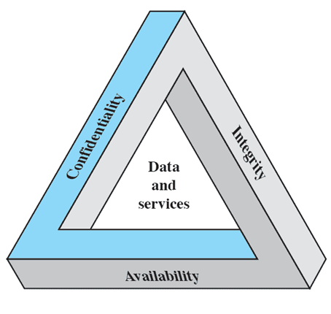
The Security Requirements Triad

Slide 5
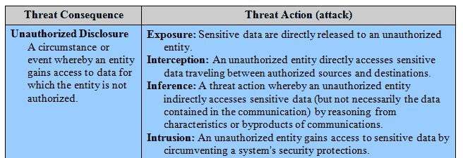
THREATS

Slide 6
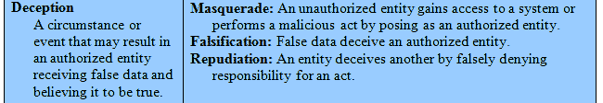
THREATS

Slide 7
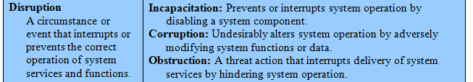
THREATS

Slide 8
THREATS

Slide 9
Phishing
Phishing is the act of attempting to acquire information such as username, password and credit card details as a trustworthy entity in an electronic communication.
Phishing Techniques
Link manipulation
Filter evasion
Website forgery
Phone phishing

Slide 10
Phishing
Types of Phishing
Deceptive
Malware-Based
DNS-Based
Man-in-the-Middle Phishing
Content-Injection

Slide 11
Phishing
Causes of Phishing
Misleading e-mails
No check of source address
Vulnerability in browsers
No strong authentication at websites of banks and financial institutions
Limited use of digital signatures
Non-availability of secure desktop tools
Lack of user awareness
Vulnerability in applications

Slide 12
Trojan Horse
Useful program that contains hidden code
When invoked performs some unwanted or harmful function
Can be used to accomplish functions indirectly
An unauthorized user could not accomplish directly
User may set file permission so everyone has access

Slide 13
Virus
Sub microscopic entity consisting of a single nuclei
A virus is a small piece of software that piggybacks on real programs in order to get executed
Once it’s running, it spreads by inserting copies of itself into other executable code or documents

Slide 14
Typical things that some current Personal Computer (PC) viruses do
Display a message
Erase Files
Scramble data on disk
Cause erratic screen behavior
Halt the PC
Many viruses do nothing obvious at all except spread!

Slide 15
Worms
Worm - is a self-replicating program, similar to a computer virus. A virus attaches itself to, and becomes part of, another executable program; however, a worm is self-contained and does not need to be part of another program to propagate itself.

Slide 16
Worms
Worms – is a small piece of software that uses computer networks and security holes to replicate itself. A copy of the worm scans the network for another machine that has a specific security hole. It copies itself to the new machine using the security hole, and then starts replicating from there, as well.
They are often designed to exploit the file transmission capabilities found on many computers.

Slide 17
Adware vs. Spyware
Adware typically only annoys the user while Spyware will annoy and collect information to be sent back to the creator.
Generally speaking Spyware is seen as more invasive and subversive Adware.
Not all Adware and Spyware can be considered bad.

Slide 18
Spyware and Adware that isn’t bad? What?
Some desirable applications, like kazaa, require the bundled adware to be running in order to work
Monitoring child internet access
Some people like targeted advertising

Slide 19
Why Adware and Spyware?
Keeping installed software up to date
Preventing software piracy
Preventing illegal or unacceptable use of installed software
Gathering of Marketing Information
Annoying Advertisement
Complete Privacy Invasion
Illegal or Unacceptable use of resources
Password, e-mail, and username harvesting

Slide 20
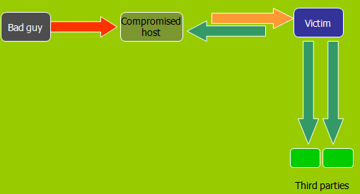
Denial of Service Attack
When a denial of service (DoS) attack occurs, a computer or a network user is unable to access resources like e-mail and the Internet. An attack can be directed at an operating system or at the network.

Slide 21
What is distributed denial of service?
A distributed denial of service (DDoS) attack is accomplished by using the Internet to break into computers and using them to attack a network. Hundreds or thousands of computer systems across the Internet can be turned into “zombies” and used to attack another system or website.

Slide 22
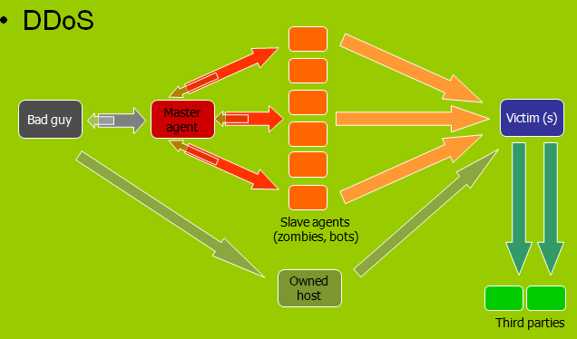
Distributed Denial of Service

Slide 23
SNIFFERS
Definition:
Sniffers are tools that can capture all data packets
being sent across the entire network in the raw form.
Working:
ATTACKER---→Uses sniffer for spying-----→ VICTIM
Threats:
Corporate Espionage, Password Stealing, IP Violation, Spying, etc.

Slide 24
KEYLOGGERS
Definition:
They are spying tools that record all keystrokes made on the victim’s computer.
Working: ATTACKER-----Uses key logger for spying-----→ VICTIM
Threats:
Corporate Espionage, Password Stealing, IP Violation, Spying, etc.

Slide 25
SOCIAL ENGINEERING
Social engineering is an attack vector that relies heavily on human interaction and often involves tricking people into breaking normal security procedures.
A social engineer runs what used to be called a "con game." Techniques such as appeal to vanity, appeal to authority and appeal to greed are often used in social engineering attacks. Many social engineering exploits simply rely on people's willingness to be helpful. For example, the attacker might pretend to be a co-worker who has some kind of urgent problem that requires access to additional network resources

Slide 26
References
Atul Kahate, “Cryptography and Network Security”, Second Edition, McGrawHill, 2010.
Information System Security, Nina Godbole, Wiley India, First Edition 2009.
Fundamentals of Information System Security, David Kim, Second Edition 2013.

